Slide 1



Phenology data to aid pollinator restoration
Hayley Limes
Erin Posthumus – USA-NPN
Statewide Symposium
4/17/21

Slide 2
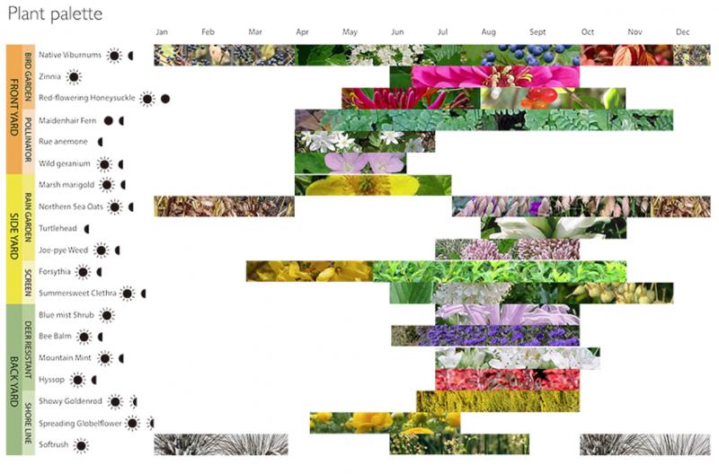
Pollinator Restoration and Phenophase Calendars
Long-term Goals:
Timing of flowering and seed drop for important nectar species?
How are these plant species affected by climate change?
Area of Interest: South Central US
Lack of data
Important to Monarchs
Project Aims:
Summarize Data
Lily Pan, Cornell University Department of Landscape Architecture
Notes:
Summarizing current data for important species in the south-central region
Determine current geographic and temporal gaps

Slide 3
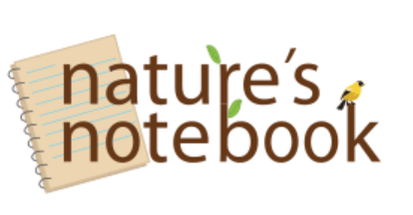

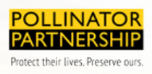
Priority Species
Nature’s Notebook & Nectar Connectors:
Others:
Species Used:
All Nectar Connectors species
Species that occurred on two or more lists
Notes:
Used pollinator partnership, xerces society, nature’s notebook, and species lists to choose pollinators

Slide 4
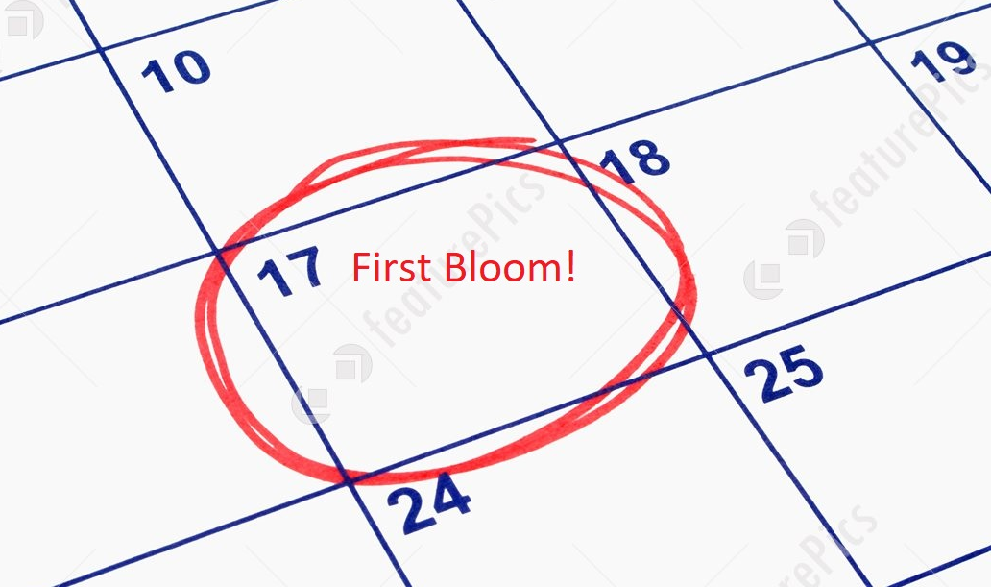
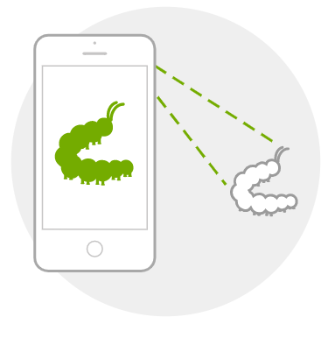

Data Sources
Nature’s Noteb:
Advantages: Good quality Data
I-Naturalist:
Advantages: Good quantity of data
Data were combined in order to create summary visualizations
Source:I-Naturalist

Slide 5
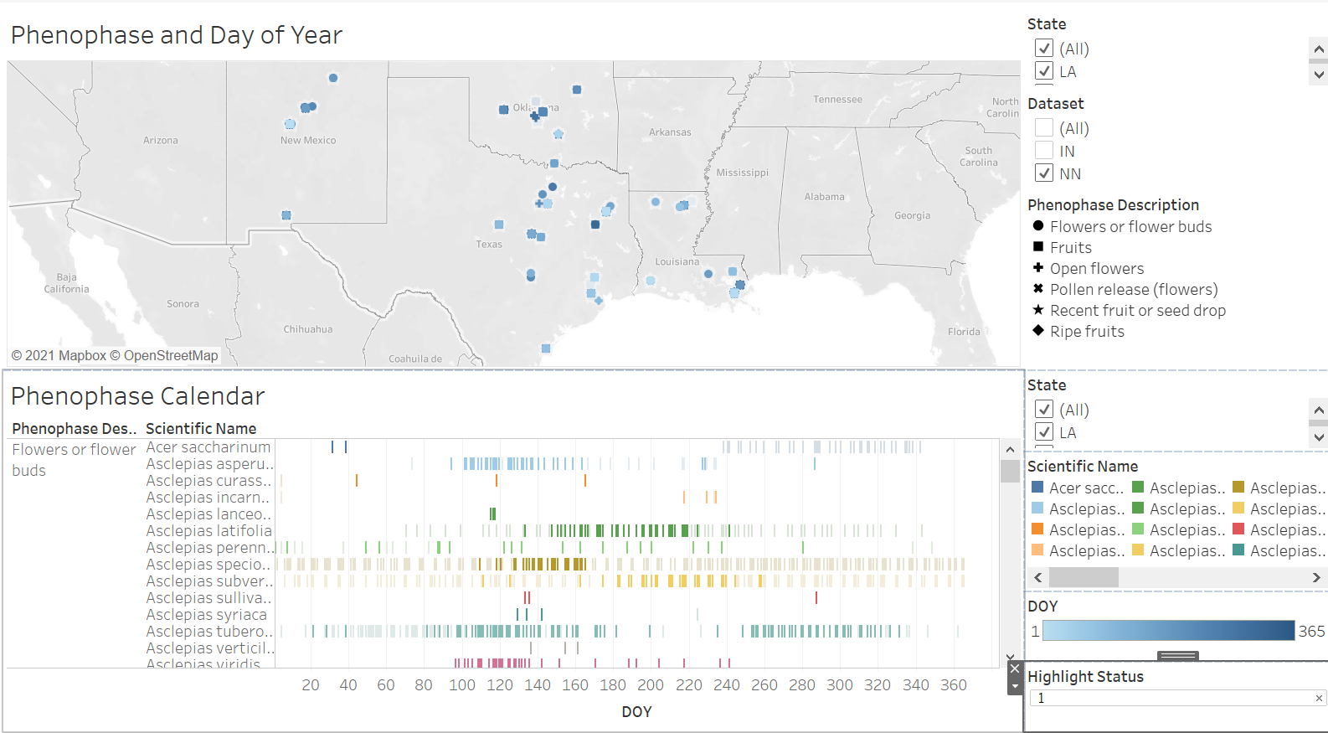
Nature’s Notebook Data – Data Amount

Slide 6
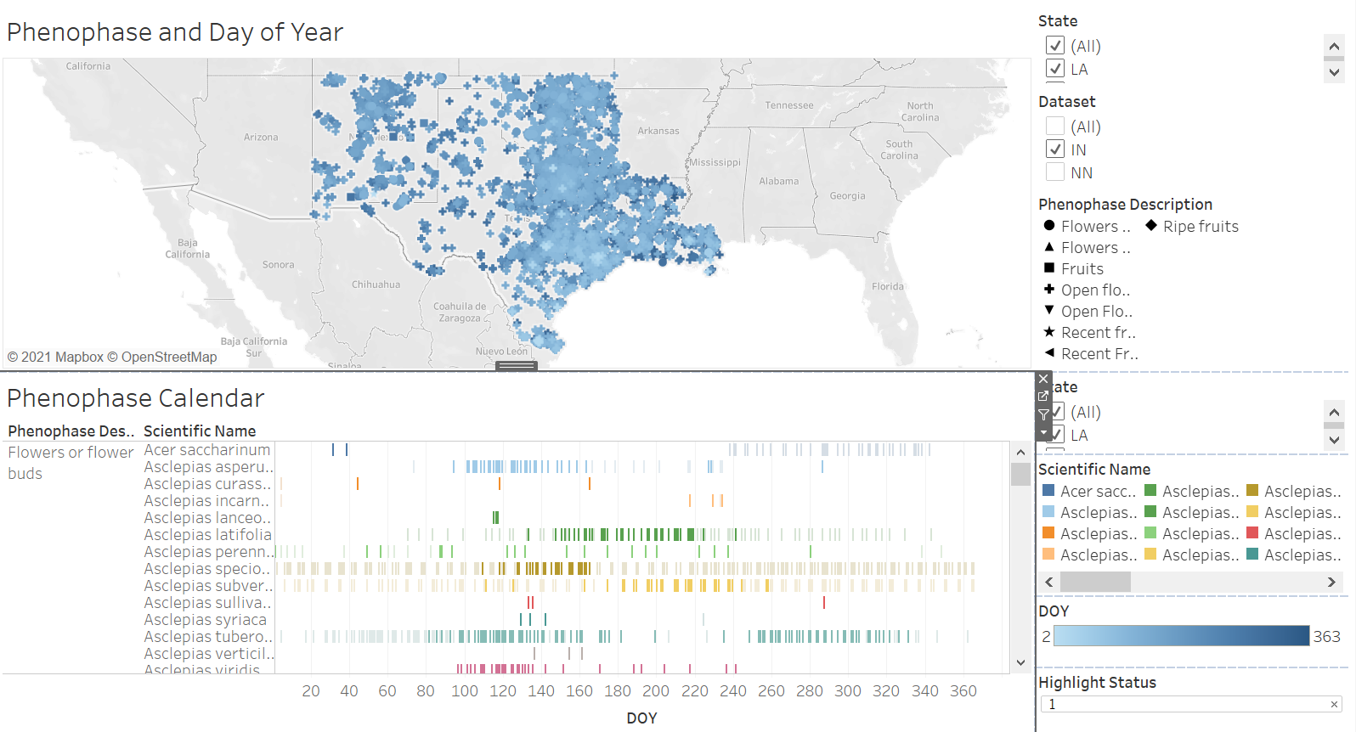
I-Naturalist Data – Data Amount

Slide 7
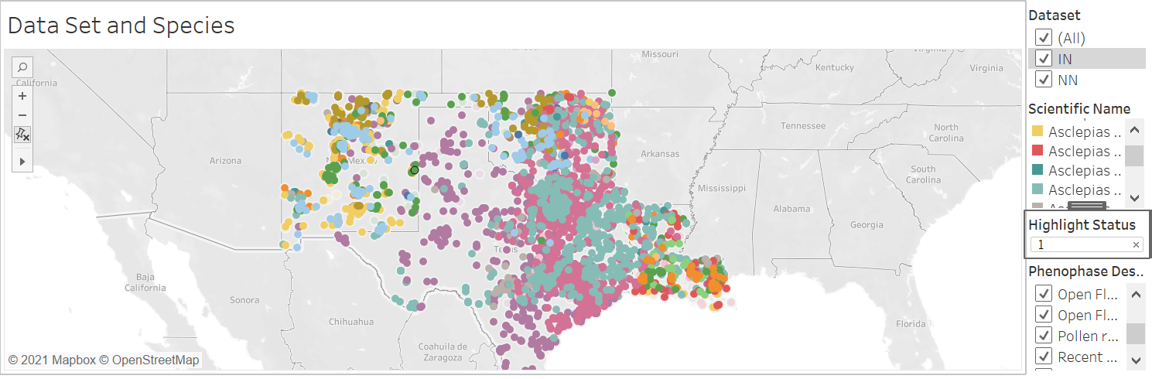
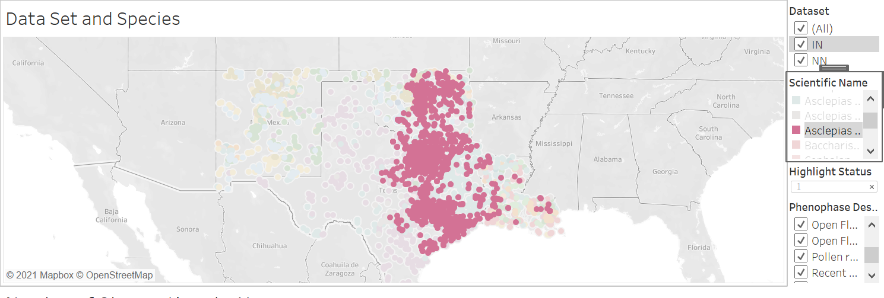
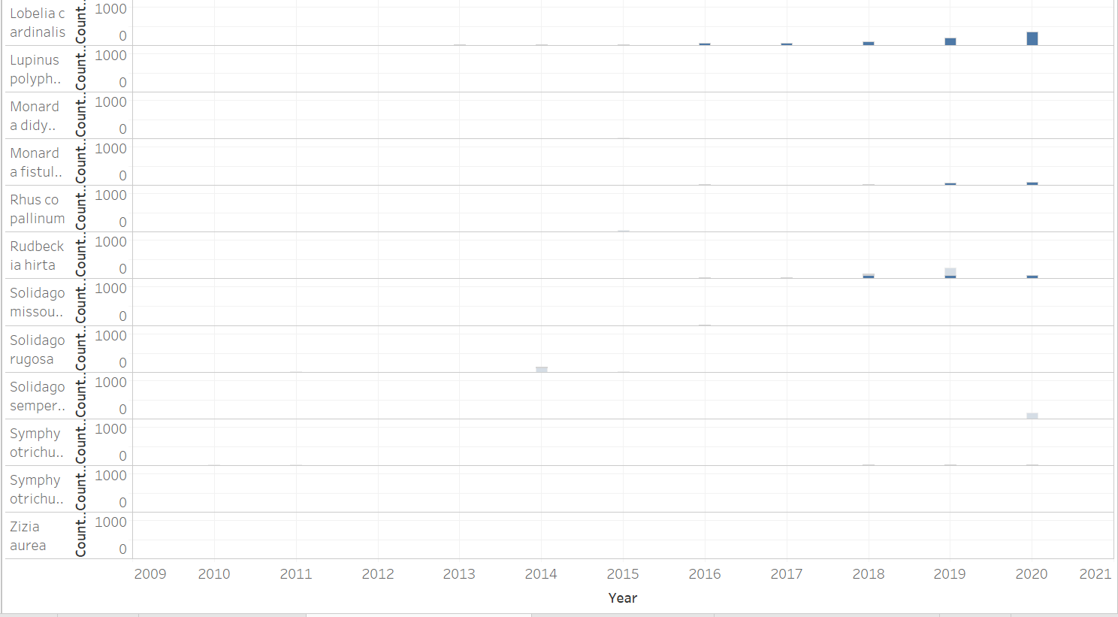
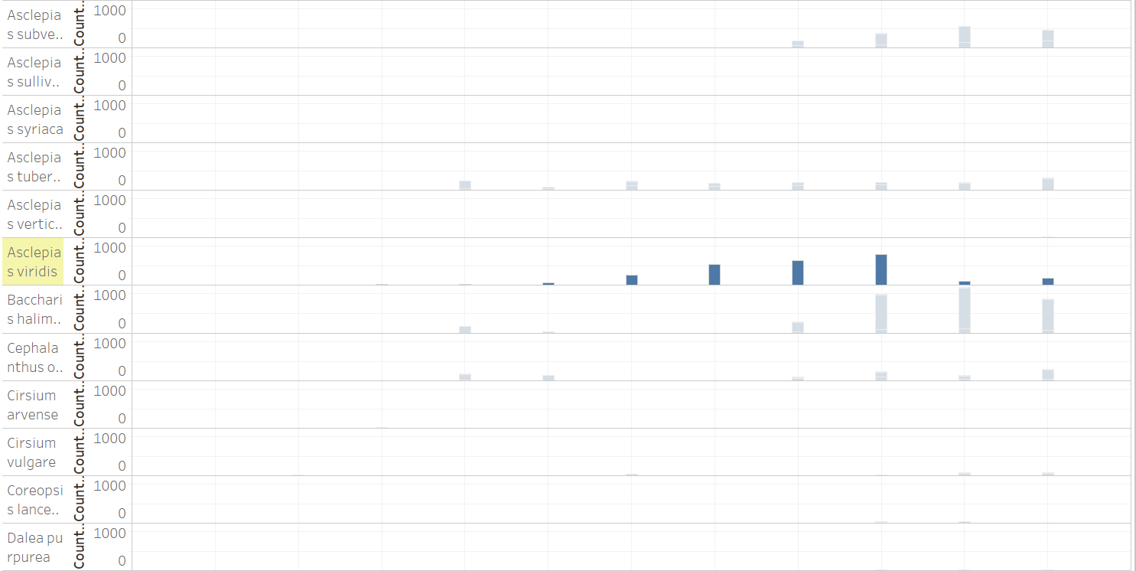
Temporal Data Summary

Slide 8
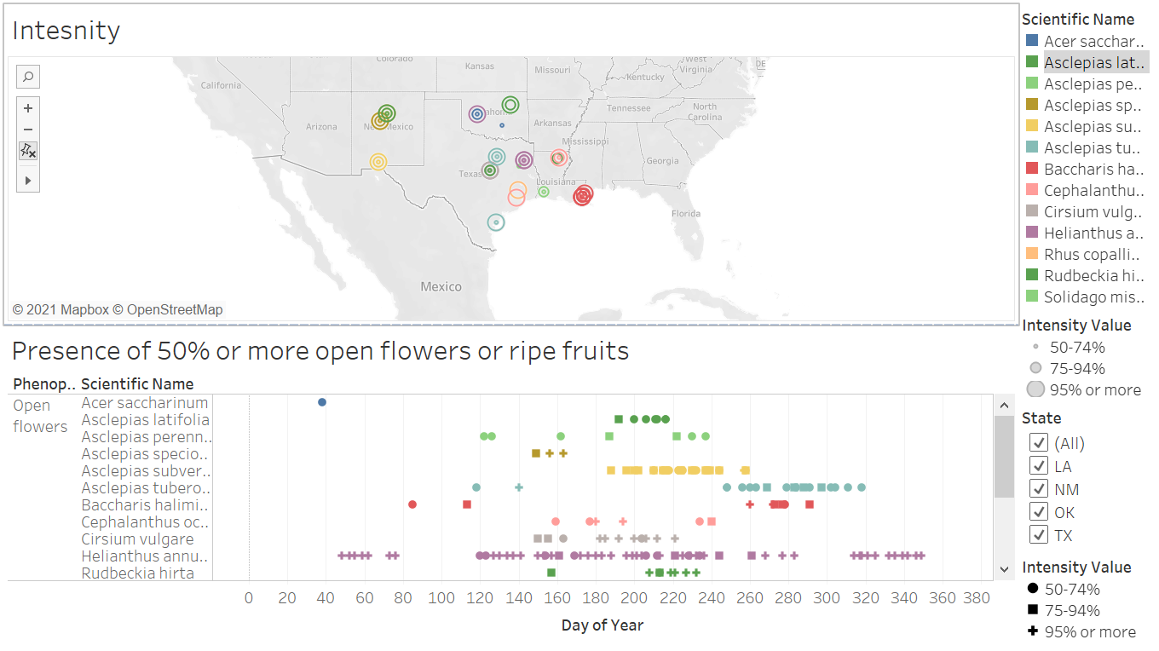
Nature's Notebook Intensity Data

Slide 9
How will Data be Used
Data will be presented to USA-NPN natural resource management partners in the South Central US
Includes: US Fish and Wildlife Service, State wildlife departments, Tribes, Nature Centers, etc
Current available data will be used to target future data collection efforts:
Determine species of interest
Determine at areas of concern for species

Slide 10
Thank You!

